Slide 1
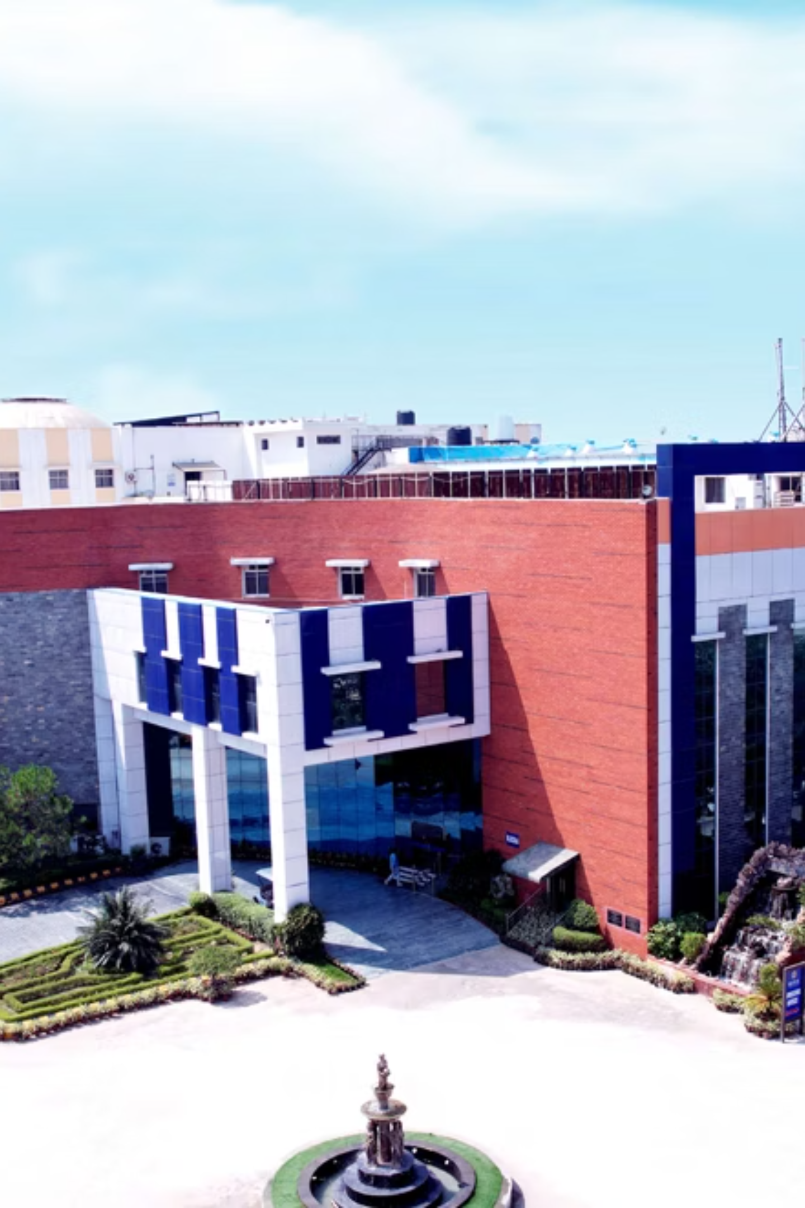
Campus Bot: AI-Powered Campus Navigation
Welcome to the future of campus navigation! This presentation introduces Campus Bot, your intelligent guide for SRMIST Modinagar, designed to make finding your way around effortless and efficient.

Slide 2

Introduction
What is Campus Bot?
Why Campus Bot?
An AI-powered chatbot combined with an interactive map.
Navigating a large campus is often confusing for newcomers.
Designed specifically for SRMIST Modinagar.
Traditional signboards and paper maps are limited and outdated.
Helps students, visitors, and faculty easily find classrooms, labs, hostels, and other facilities.
A digital, real-time assistant makes navigation easier, faster, and more interactive.

Slide 3
Problem Statement
Campus Complexity
Generic Map Limitations
Large campuses are confusing to navigate for students, visitors, and staff, leading to wasted time.
Apps like Google Maps don't provide campus-specific routes (hostels, classrooms, labs, canteens, etc.).
No Indoor Navigation
Limited Assistance
Lack of indoor navigation for multi-floor buildings, elevators, and stairs, creating significant hurdles.
No personalized assistance for quick queries like "Where is Hostel A?", causing frustration and inefficiency.

Slide 4
Our Key Objectives
01
02
03
Accurate Navigation
Intuitive Chatbot
Integrated Solution
Provide clear and precise directions to any location on campus, minimizing confusion.
Enable users to interact naturally using text queries for seamless information retrieval.
Combine interactive map visualization with AI-based query handling for a powerful tool.
04
05
Enhanced UX
Future Scalability
Deliver a modern UI with smooth animations, making navigation simple, engaging, and efficient.
Design a system that can grow with more features like voice commands, AR, and real-time tracking.

Slide 5





Campus Bot System Architecture
User Interface
Frontend with Chatbot & Interactive Map (React + Tailwind + Framer Motion).
Backend Logic
Handles queries and navigation processing (Node.js + Express / FastAPI planned).
Data Storage
Stores building names, coordinates, facility data (MongoDB / PostgreSQL planned).
AI Processing
Interprets user queries, finds location, generates optimal routes.
Route & Response
Delivers clear directions and interactive map displays back to the user.
This streamlined flow ensures rapid query processing and accurate navigation.

Slide 6

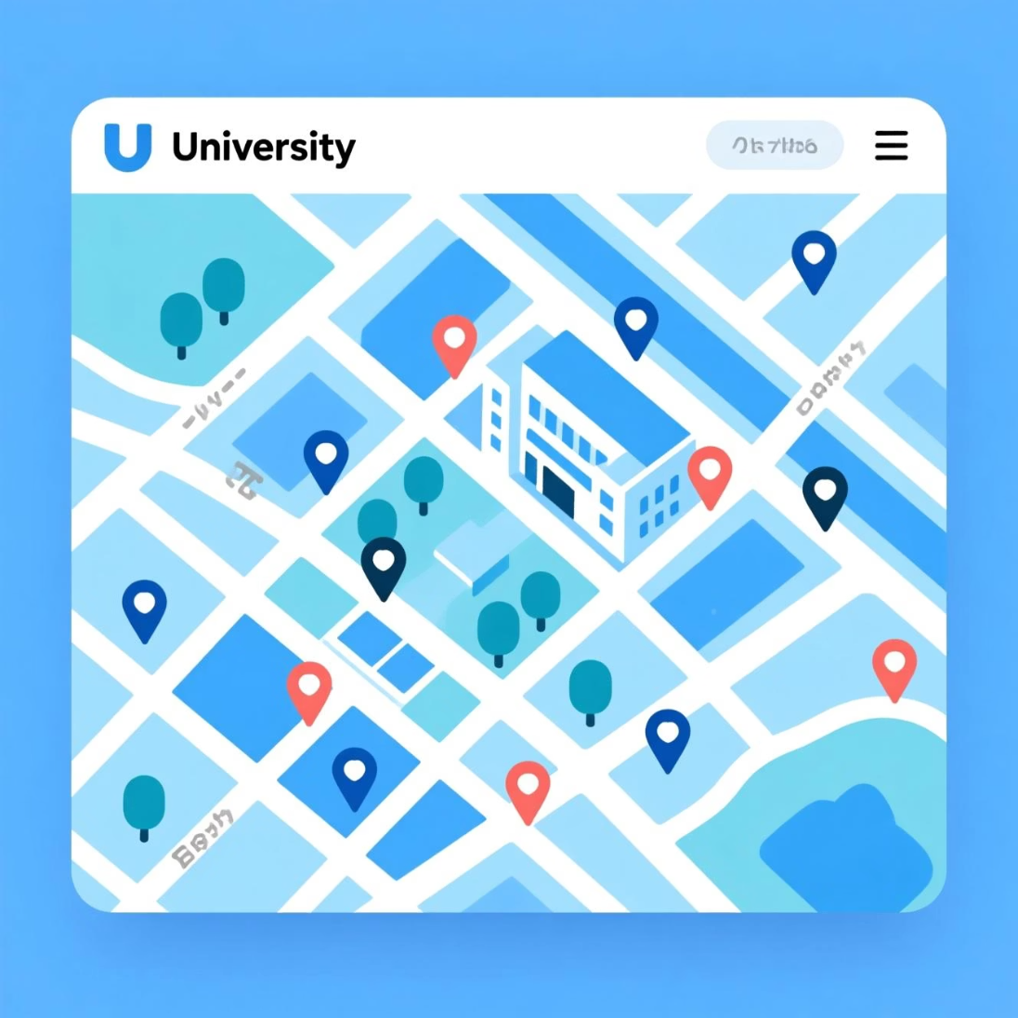
Core Features
Chatbot for Natural Queries
Interactive Map
Users can ask: "Where is the basketball court?" or "Show me the library." The chatbot understands natural language.
Functions similarly to Google Maps but is exclusively focused on the SRMIST campus layout.
Additionally, new facilities can be easily added to the Expandable Knowledge Base, and a FastAPI backend ensures real-time, smooth interactions.

Slide 7



Our Robust Tech Stack
Frontend
Backend
Map Integration
HTML, CSS, JavaScript (botverse.html) handle the chatbot UI and map interface for a smooth user experience.
Python (FastAPI, Uvicorn) processes chatbot queries and efficiently serves data, ensuring quick responses.
Leaflet.js + OpenStreetMap display the campus map, markers, and navigation paths, providing clear visuals.
AI / Logic
Database
Natural Language Processing (NLP) enables intent recognition and accurate location mapping for precise directions.
Custom JSON / Database stores facility names, latitude-longitude coordinates, and other essential details for easy access.

Slide 8
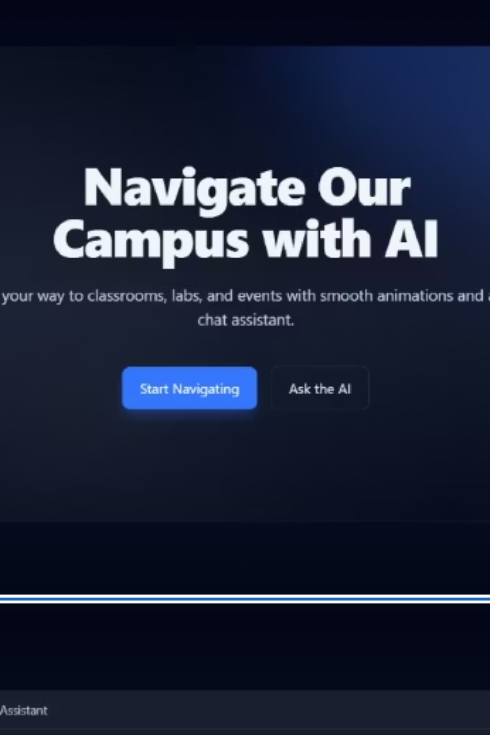
Campus Bot: Chatbot Interface
This is the welcoming screen of Campus Bot, ready to assist users with their navigation needs before any conversation begins.

Slide 9
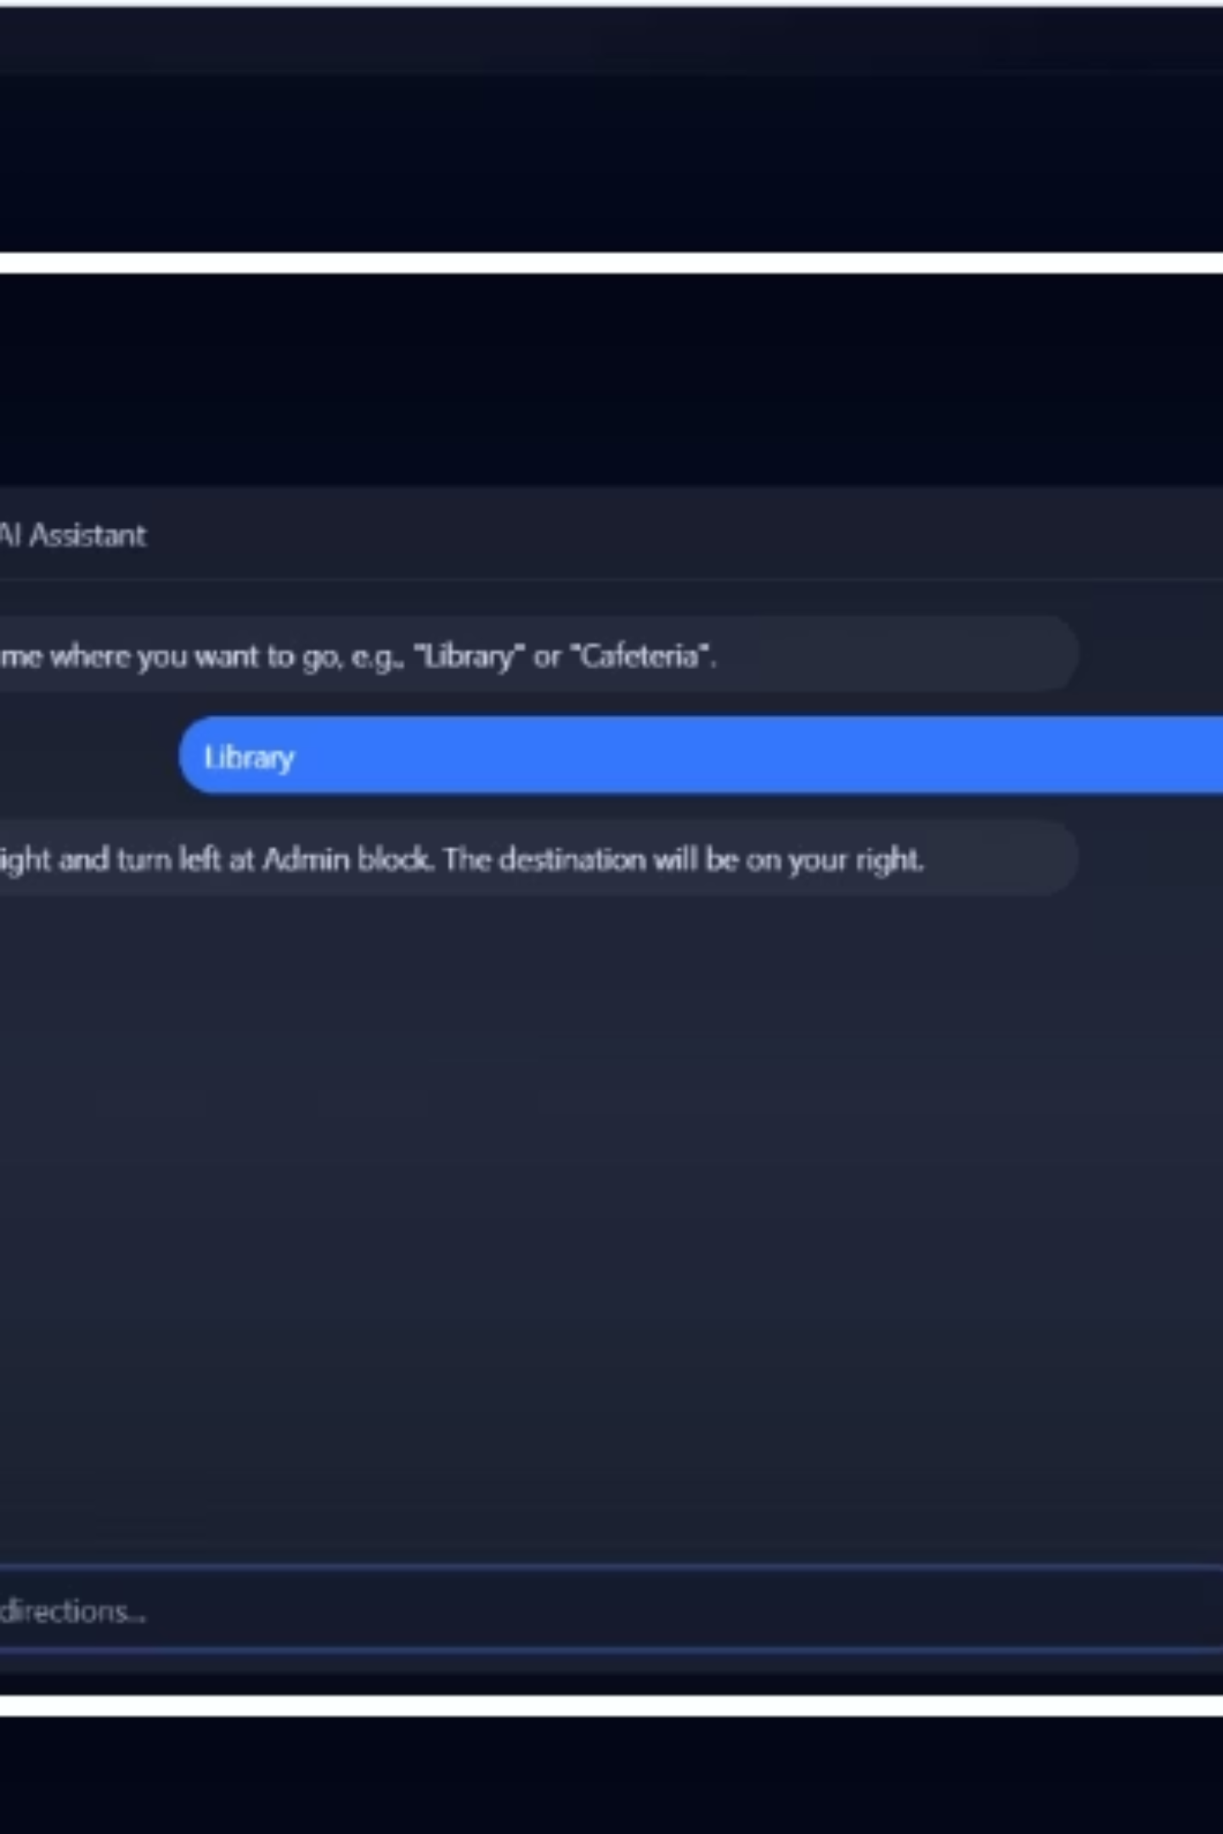
Campus Bot: Backend in Action
Witness Campus Bot seamlessly operating with its FastAPI backend, demonstrating efficient data processing and responsiveness.

Slide 10
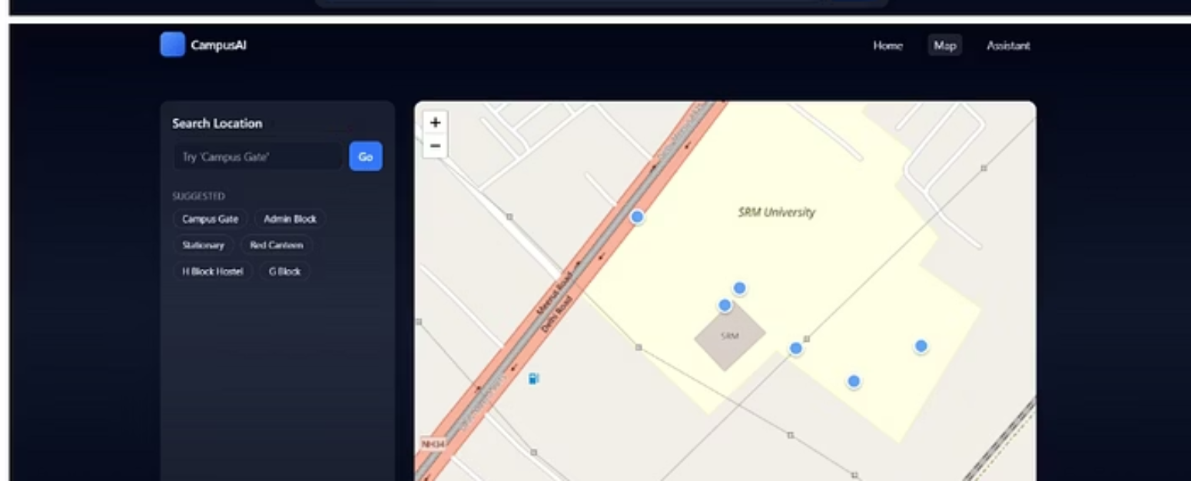
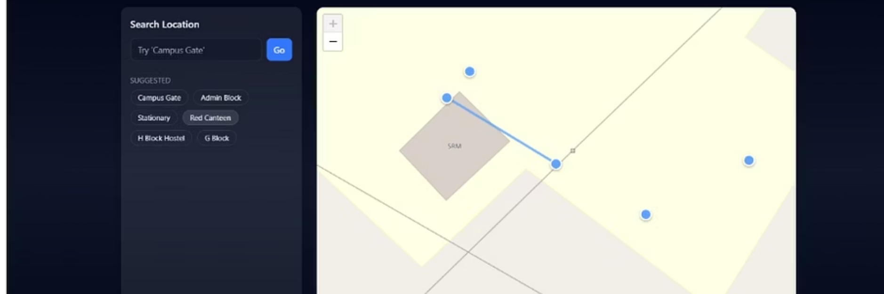
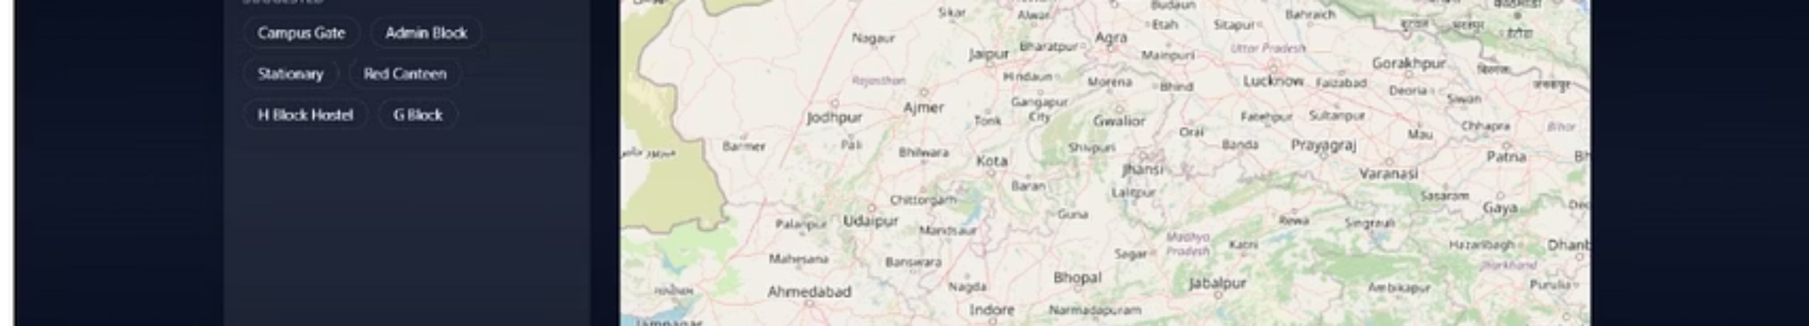
Interactive Campus Map with Navigation Path
Explore the dynamic interactive map feature, showcasing precise navigation paths to guide you effortlessly across the SRMIST Modinagar campus.

